Slide 1



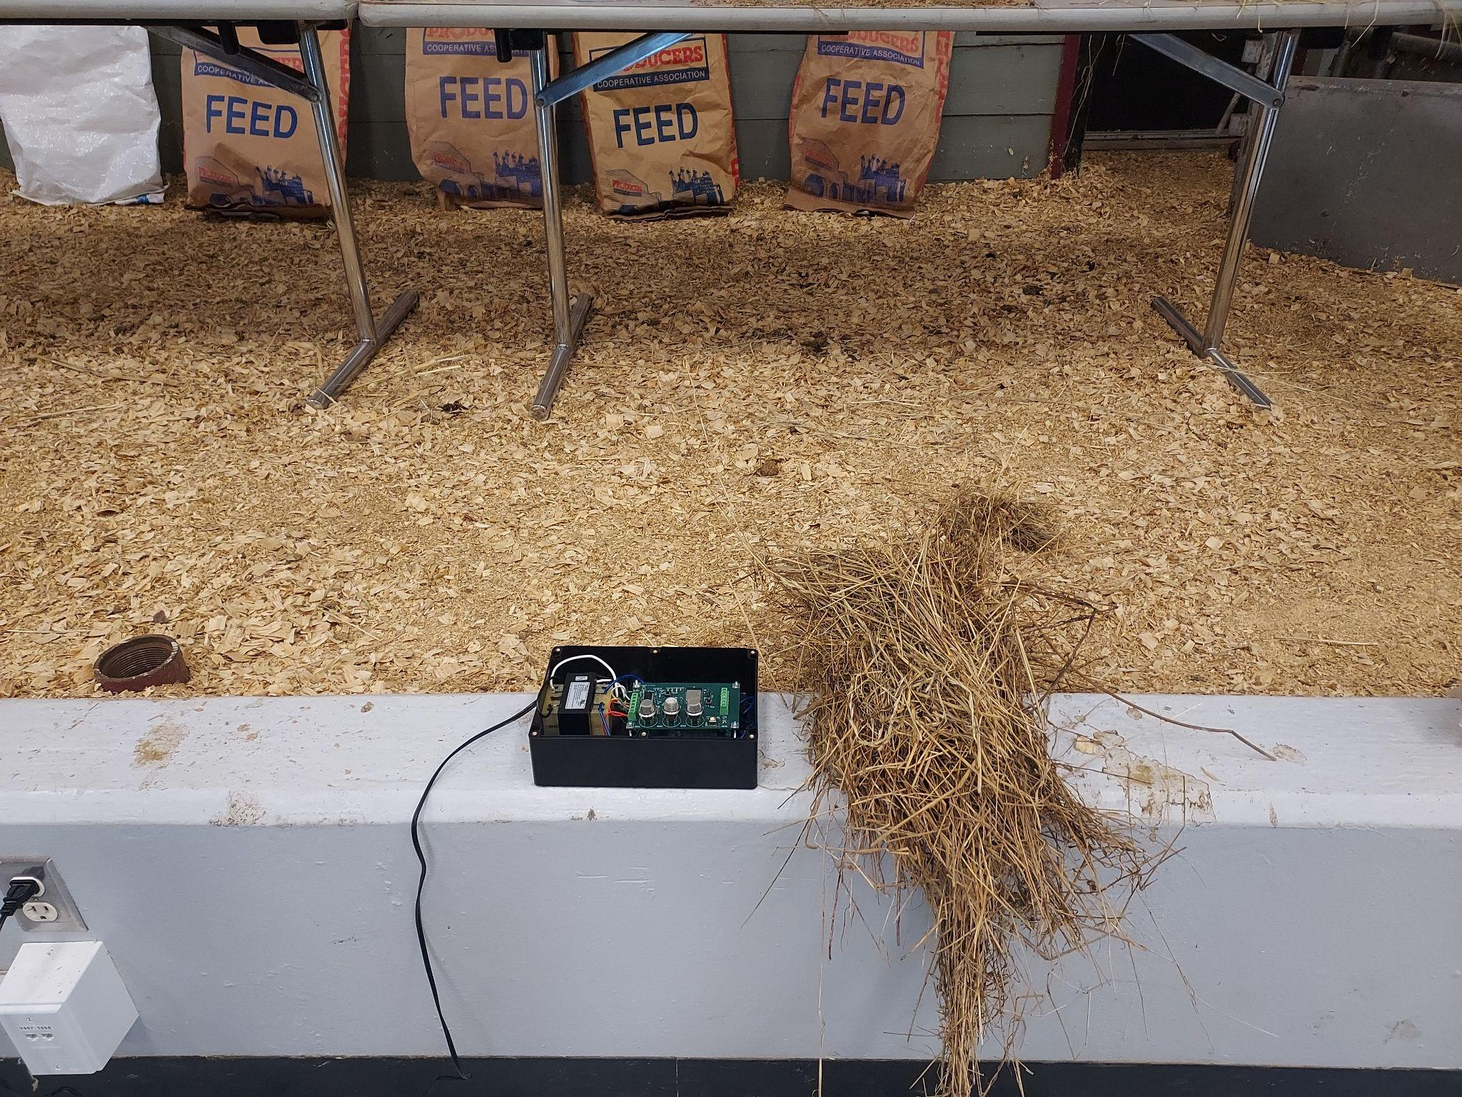
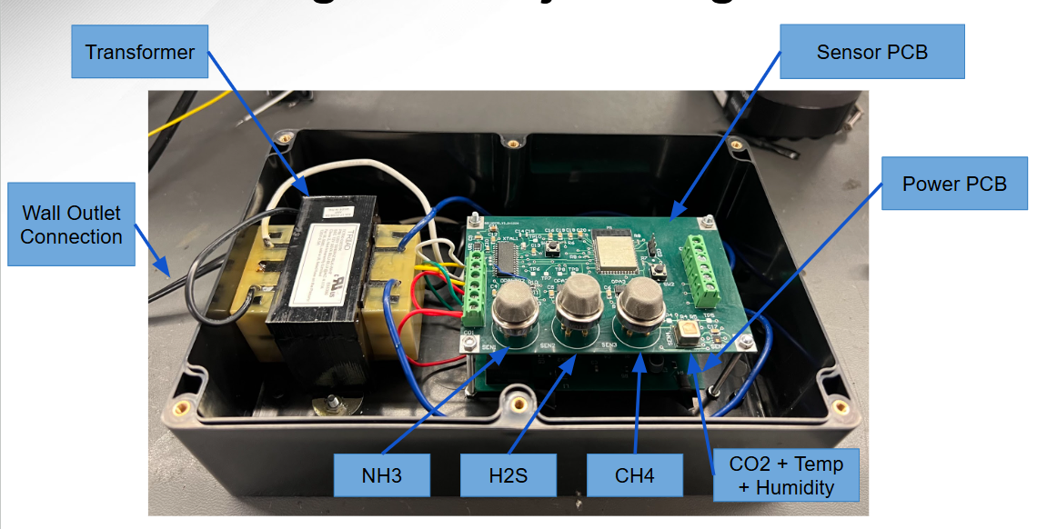
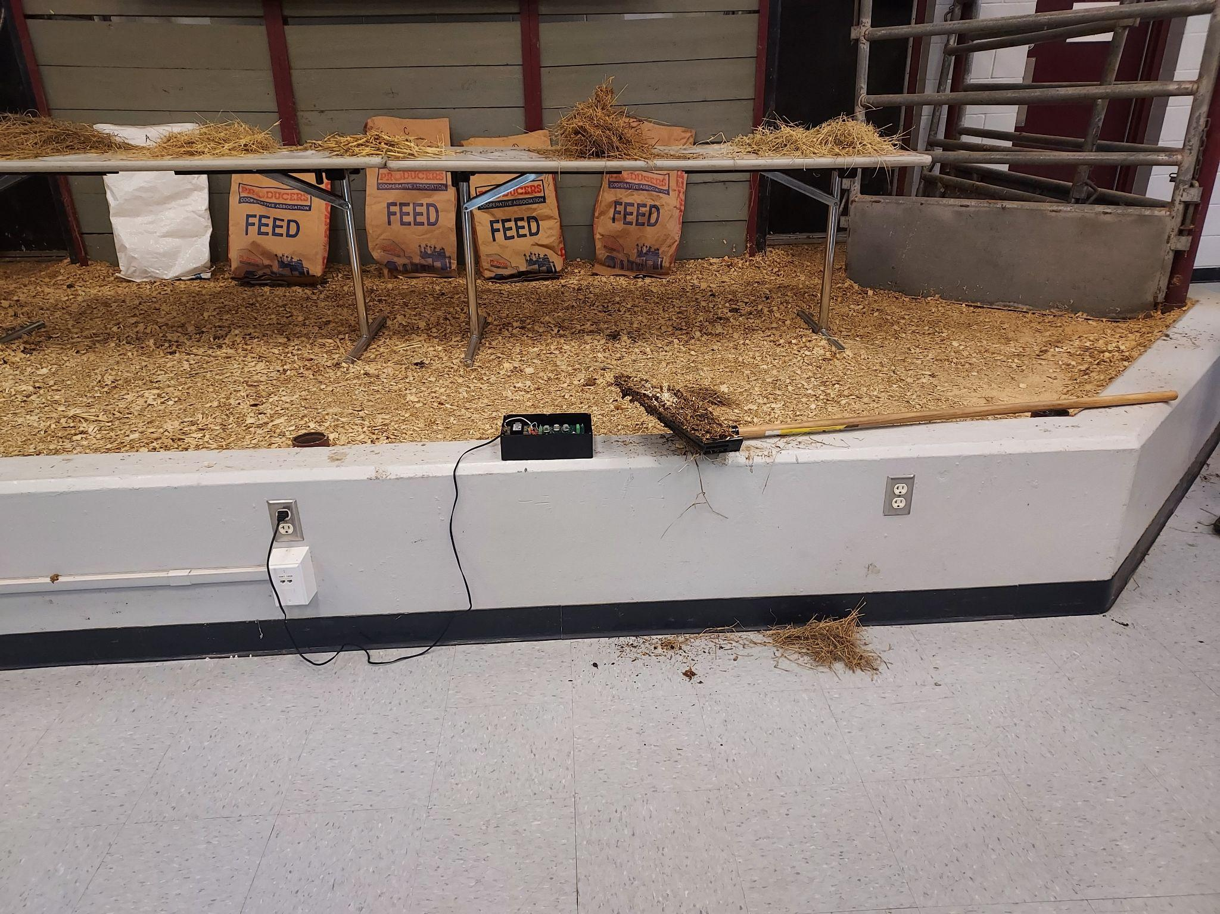
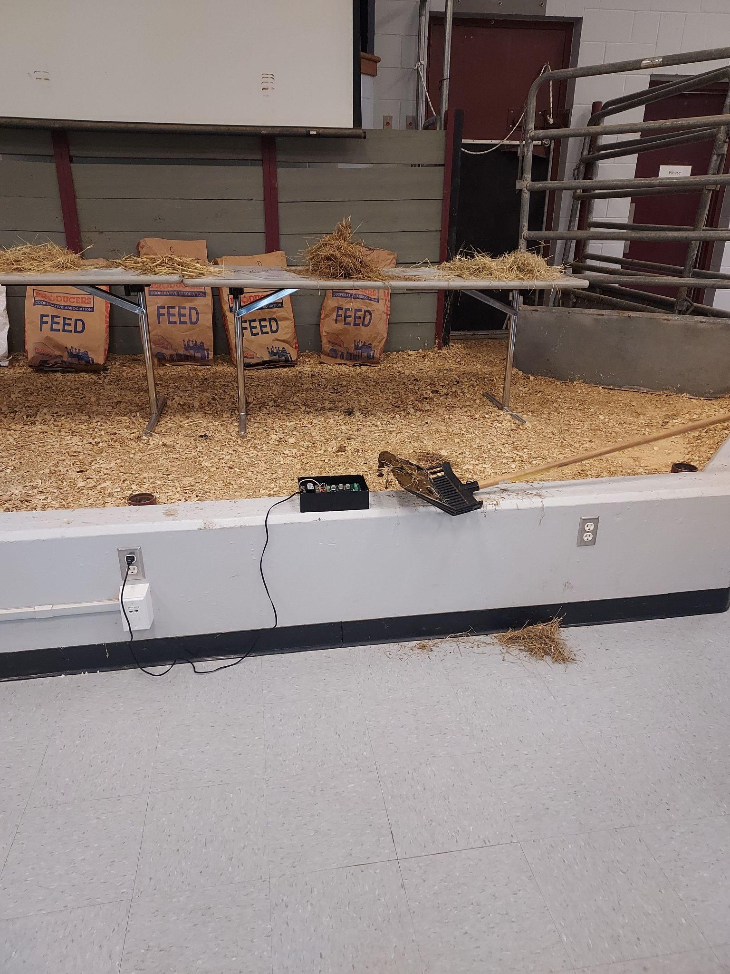
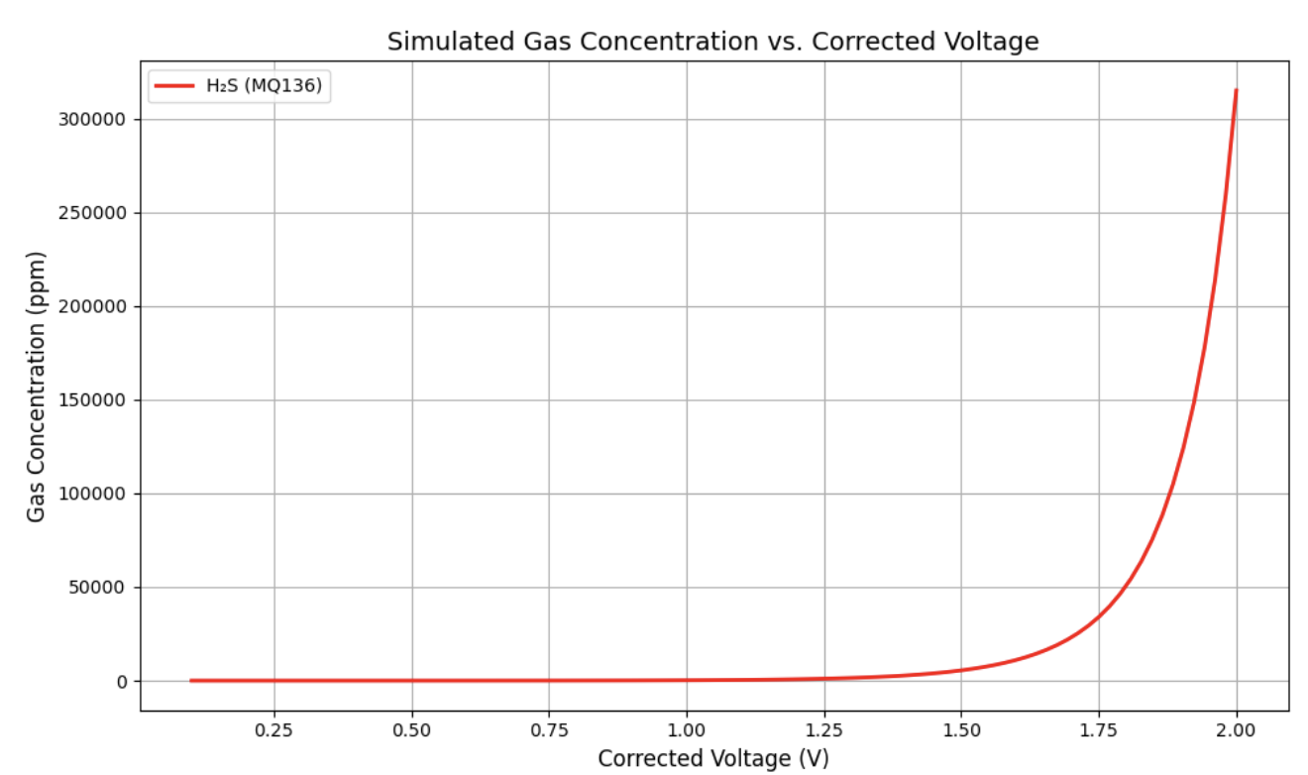
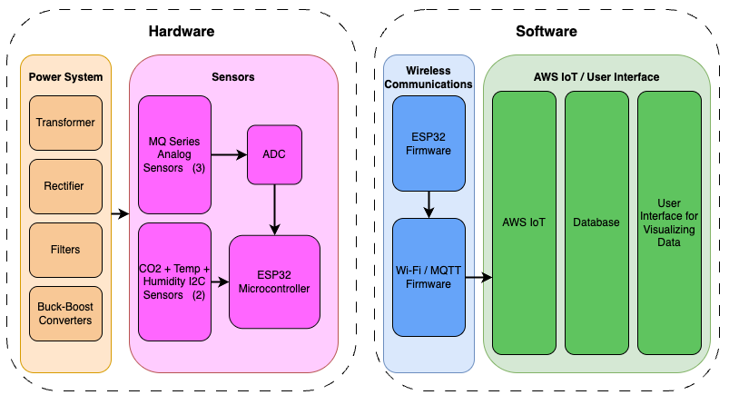
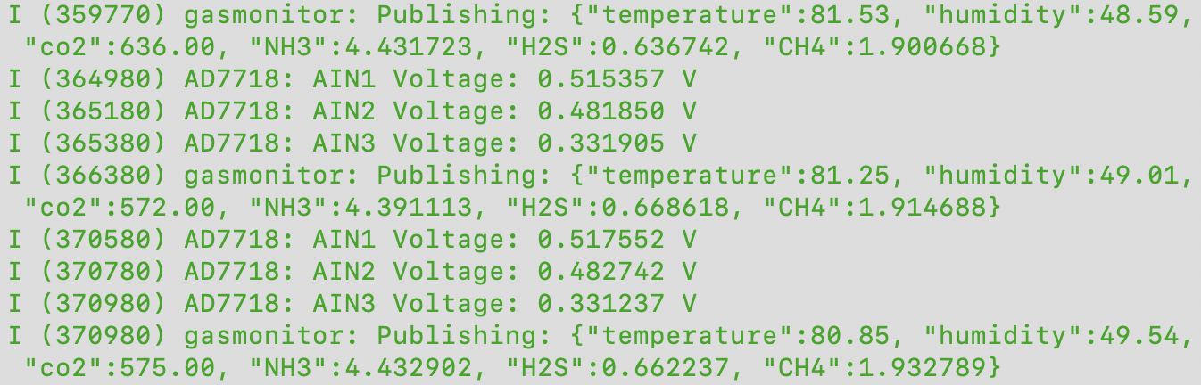
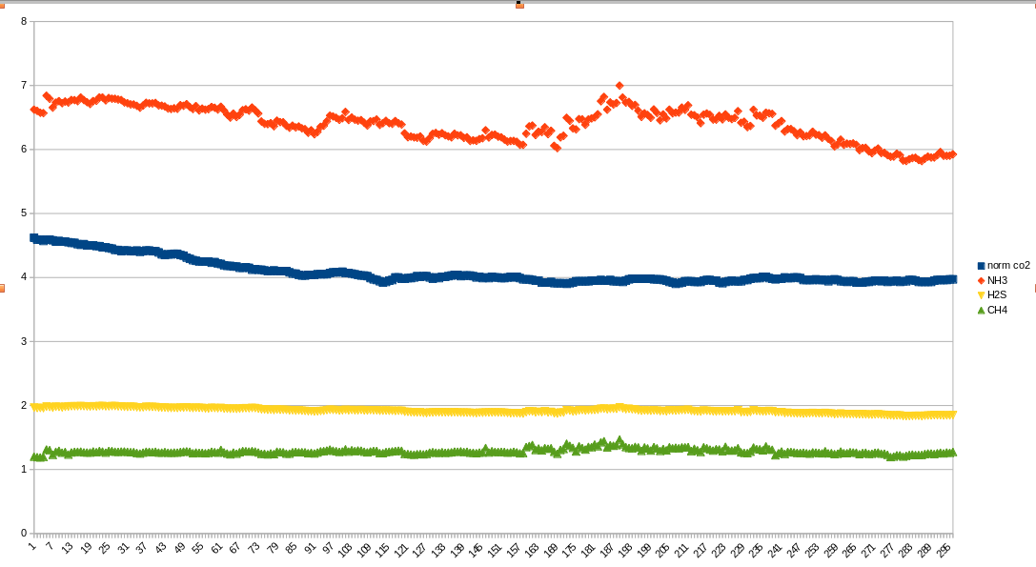
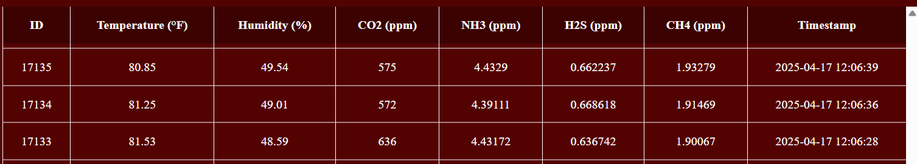
Booth Number: 336
Livestock Gas Monitor
Matthew Owen, Joaquin Salas, Tanmay Sarkar, Blake Schwartzkopf
Dr. John Lusher II
Global Hawk Solutions
<- Check out our website!
Departmental Logo
Problem Definition
Animal farms often experience a buildup of harmful gases that can threaten the health of both workers and animals. We were tasked with designing and implementing a durable, real-time gas monitoring system that can track harmful gases in animal farms. The gases monitored are Ammonia, Hydrogen Sulfide, Carbon Dioxide, and Methane.
Engineering Analysis
The complexity of our project stems from the integration between hardware and software components. Engineering analysis has been done using Altium, AWS, MySQL, and ESP-IDF.
The figure below shows the hydrogen sulfide concentration vs. input voltage. Gas concentration is derived from Rs using a logarithmic regression model based on the MQ-series sensor datasheet.
C.The housing unit was designed to securely mount all printed circuit board with special attention made to orient sensors in the optimal positions.
Hay
Damp cow bedding
Cow patty
Methodology
Our project is broken into 4 different subsystems, power, sensors, microcontroller & wireless communication, and UI
Figure 1. Subsystem breakdown block diagram.
Power
• 120V AC sent to a transformer that outputs 12V AC.
• Printed circuit board (PCB) rectifies AC to DC
• Buck-boost regulators and filter capacitors convert voltage to 3.3V, 5V, and -8V with current up to 1A
Sensors
• Designed PCB with 3 analog sensors, 2 I2C sensors, ADC, and microcontroller
• Determined gas concentrations from voltage detected
Microcontroller + Wireless Communication
• Programmed microcontroller to interface with gas sensors
• Transmitted real-time sensor data to AWS IoT over Wi-Fi using MQTT protocol
UI + Database
• Implemented a MySQL Database to store all data
• Connected database through Amazon Web Services -> Deployed website using AWS Elastic Beanstalk
Figure 5. Gas monitor image with labeled parts
Figure 7. Testing system next to various stimuli
Outcomes
Our gas monitoring system was able to successfully detect all intended gases along with temperature and humidity. During our final test, we were able to achieve continuous operation for 3 hours, collecting 2160 gas concentration data points.
Impact
This system improves animal health monitoring by collecting gas concentration data via real-time, remote-access dashboard.
Early Detection: We can be alerted very early if there are hazardous gas levels present.
Manual Inspection: We can use this to minimize the manual labor required in inspecting the overall health of the animal and its environment
Data-Driven Decision Making: Keeping track of the logs of data long-term would help us make decisions based on the statistics.
Figure 2. H2S Concentration vs Input Voltage
Farm Test
The base state for the test was sitting in the room with no elements placed next to it. When damp cow bedding was introduced, there was a spike in ammonia and a smaller spike in methane and hydrogen sulfide. This is consistent as ammonia is produced from damp cow bedding at 10x the magnitude of the other gases.
B. Below are screenshots of the data collection process and flow of data from the ESP32 terminal to the final web application. This data was collected on April 17, 2025 at 12:06 PM, and showcases the integration that was accomplished from the microcontroller to the AWS database, and finally to the web application.
References
AWS IoT Core Documentation
AD7718 ADC Datasheet - Analog Devices
AWS RDS (Relational Database Services) - MySQL
Flask Web Framework Documentation
AWS Elastic Beanstalk Documentation
Altium - A complete design walkthrough of Altium Designer
Figure 3. ESP32 Terminal showing data collection
Acknowledgements
We thank Justin Houck with Global Hawk Solutions, Bay Area Houston, Dr. John Lusher II, and Texas A&M Engineering for guidance, support, and funding.
Figure 4. Web application displaying data
Figure 6. Red NH3, Blue CO2, Yellow H2S, Green CH4

